Slide 1
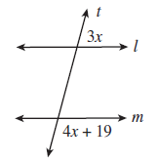
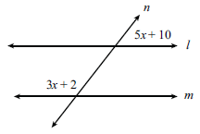
Warm-up
Find x
a) b)

Slide 2
Triangle Sum, Base Angles, & Exterior Angles

Slide 3
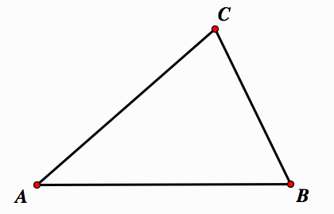
Triangle Sum Theorem
The sum of the interior angles in a triangle is
180º
Geogebra

Slide 4
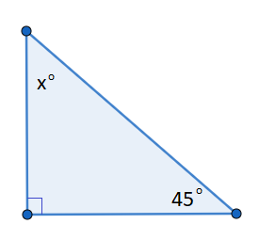
Example one:
Find x and all angle measures for the following:

Slide 5
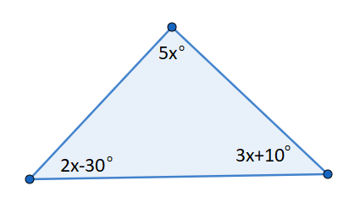
Example two:
Find x and all angle measures for the following:

Slide 6
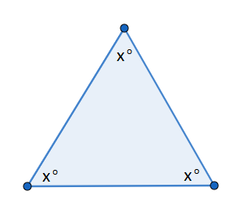
Example three:
Find x and all angle measures for the following:

Slide 7
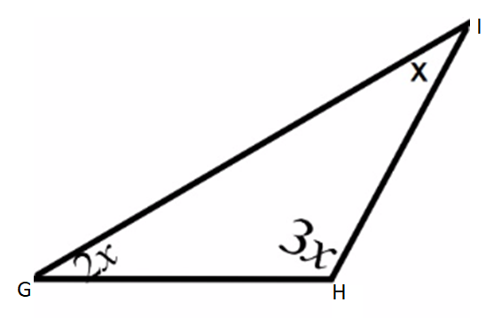
Plickers!
Which of the following is the measure of angle G?
30
180
60
90

Slide 8
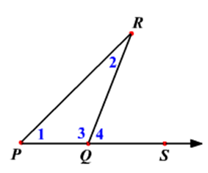
Exterior Angle Theorem
The measure of an exterior angle of a triangle is equal to the sum of the measures of its remote interior angles.

Slide 9
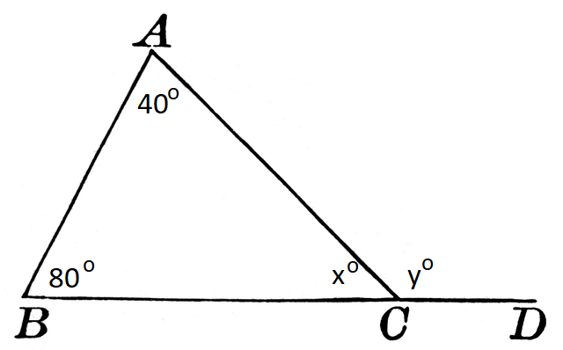
Example one:
Find x and y

Slide 10
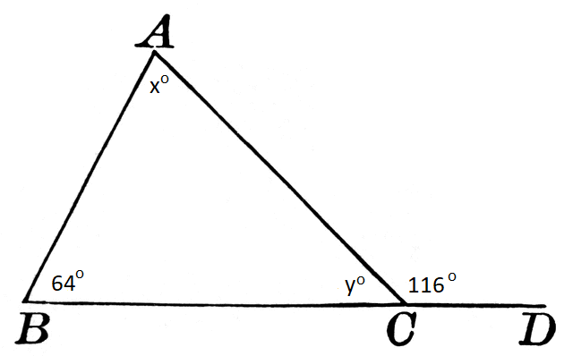
Example two:
Find x and y

Slide 11
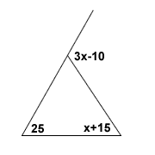
Example three:
Solve for x and find all missing angle measures.

Slide 12
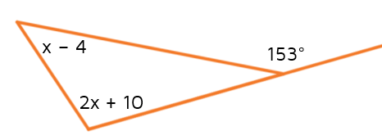
Plickers!
What is the value of x in the figure below?
A) 153 C) 108
B) 45 D) 49

Slide 13
Base Angle Theorem
If 2 sides in a triangle are congruent, then the angles opposite them are congruent.

Slide 14
Base Angle Theorem Converse
If 2 angles in a triangle are congruent, then the sides opposite them are congruent.

Slide 15
Equilateral Triangle Corollaries
Corollary 1: If a triangle is equilateral, it is equiangular
Corollary 2: If a triangle is equiangular, it is equilateral

Slide 16
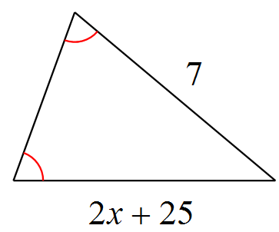
Example one: Solve for x.
12

Slide 17
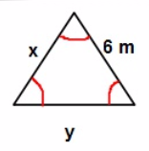
Example two: Find x, y, and all missing angle measures

Slide 18
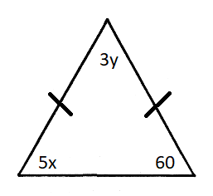
Plickers! What is the value of x in the triangle below?
12
60
20
300

