Slide 1
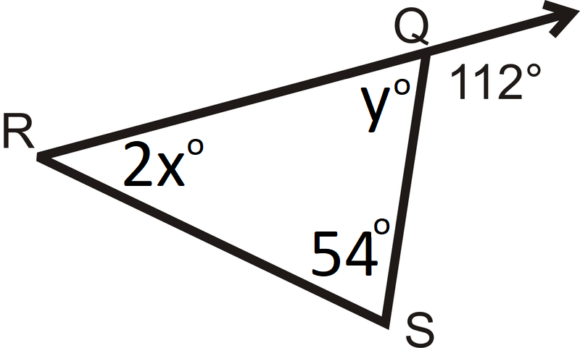
Warm-up
Find x, y, and all missing angles in the figure below:

Slide 2
Proving Triangle Congruence

Slide 3
Not-so-obvious congruence you can use:
Vertical Angles
Alternate Interior Angles (only with parallel lines)
Reflexive Property (shared side)

Slide 4
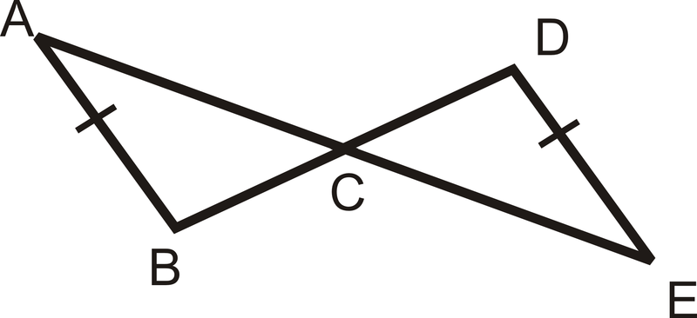
Vertical Angles Showing Congruence:
BACK

Slide 5
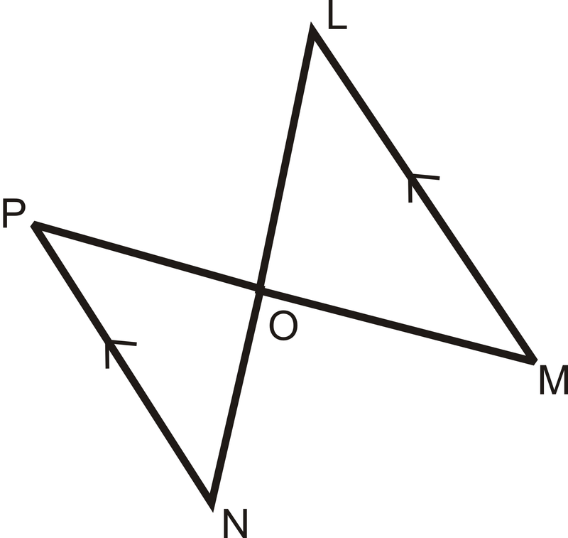
Alternate Interior Angles Showing Congruence:
BACK

Slide 6
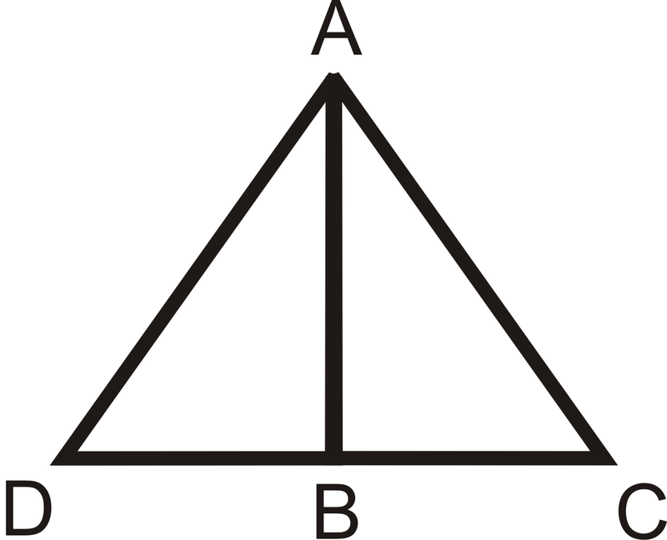
A shared side of two triangles showing congruence:
BACK

Slide 7
Triangle Congruence Postulates
Side-Side-Side (SSS)
Side-Angle-Side (SAS)
Angle-Side-Angle (ASA)
Angle-Angle-Side (AAS)
Hypotenuse-Leg (HL)
Angle-Side-Side (don’t be one!)

Slide 8
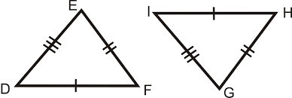
Side-Side-Side
If 3 sides of a triangle are congruent to 3 sides of another triangle, then the two triangles are congruent.
NEXT

Slide 9
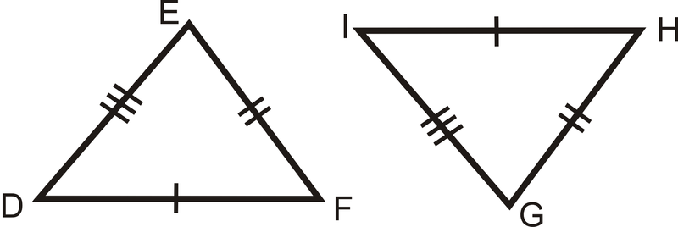
SSS Proof Example:
BACK
Prove ∆DEF ≅ ∆GHI
Statements | Reasons

Slide 10
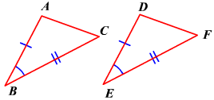
Side-Angle-Side
If 2 sides and the included angle of a triangle are congruent to 2 sides and the included angle of another triangle, then the two triangles are congruent.
NEXT

Slide 11
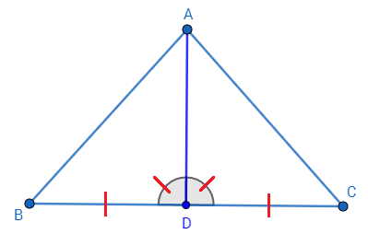
SAS Proof Example:
BACK
Prove ∆ABD ≅ ∆ADC
Statements | Reasons

Slide 12
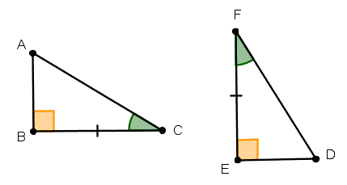
Angle-Side-Angle
If 2 angles and the included side of a triangle are congruent to 2 angles and the included side of another triangle, then the two triangles are congruent.
NEXT

Slide 13
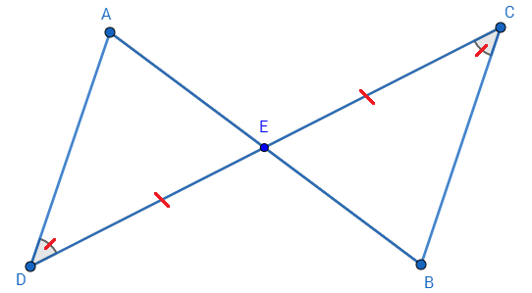
ASA Proof Example:
BACK
Prove ∆ADE ≅ ∆CBE
Statements | Reasons

Slide 14
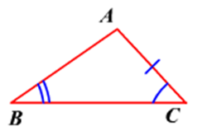
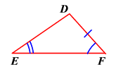
Angle-Angle-Side
If 2 angles and the non-included side of a triangle are congruent to 2 angles and the non-ncluded side of another triangle, then the two triangles are congruent.
NEXT

Slide 15
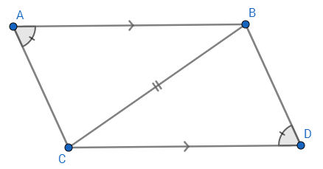
AAS Proof Example:
BACK
Prove ∆ABC ≅ ∆BCD
Statements | Reasons

Slide 16
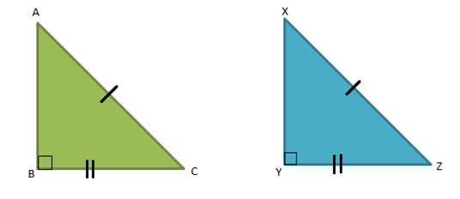
Hypotenuse-Leg (HL)
Two right triangles are congruent if they each have a congruent hypotenuse and a congruent leg.
BACK

Slide 17
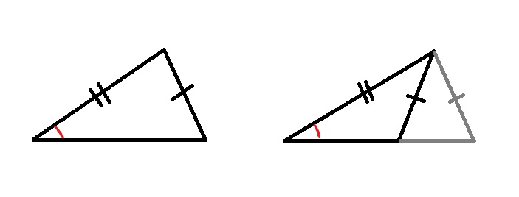
Angle-Side-Side (ASS) Counter-example:

