Slide 1
Warm-up
Find x, y, and all missing angles in the figure below:

Slide 2
CPCTC ☺

Slide 3
Corresponding Parts of Congruent Triangles are Congruent
When two triangles are congruent, all corresponding parts* of the two triangles are also congruent.
*Corresponding parts include the angles and sides from one triangle (the pre-image) to the next (the image).

Slide 4
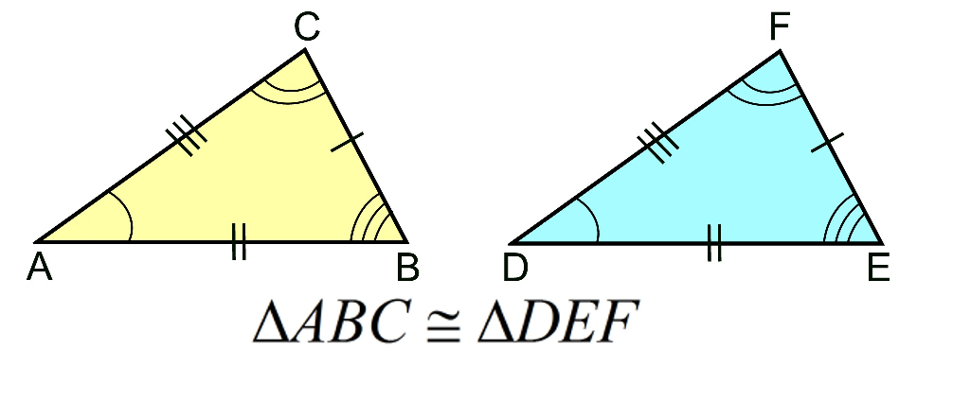
Congruence Statements
A congruence statement matches the congruent parts in the two figures by naming them in a specific order.
Not the same as
$$∆ABC≅∆FED$$

Slide 5
Writing Congruence Statements
Write a congruence statement for the two triangles, making sure to match up the corresponding parts.
Use the congruence statement you just wrote to list the pairs of congruent angles.
Use the same congruence statement from part 1 to list the pairs of congruent sides.
*Make sure to always use the proper notation!!!

Slide 6
Example one:
Congruence Statement: __________
Angles | Sides

Slide 7
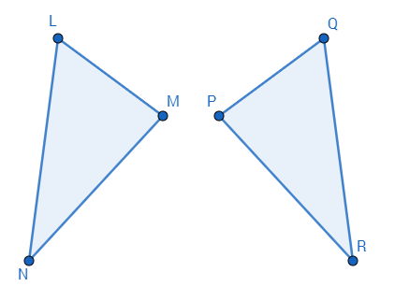
Example two:
Use the angles and sides to mark the given triangle and write a congruence statement for the two triangles.
Congruence Statement: __________
Angles | Sides
 | $$\overline{LM} \text{≅} \overline{QP}$$
$$\text{∠} \text{M} \text{≅} \text{∠} \text{P}$$ | $$\overline{MN} \text{≅} \overline{PR}$$
$$\text{∠} \text{N} \text{≅} \text{∠} \text{R}$$ | $$\overline{NL} \text{≅} \overline{RQ}$$
$$\text{∠} \text{L} \text{≅} \text{∠} \text{Q}$$

Slide 8
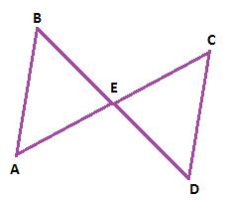
Example three:
Use the congruence statement to list all congruent sides and angles. Mark the given triangles as well.
Congruence Statement: __________
Angles | Sides
$$∆ABE≅∆CDE$$

Slide 9
Corresponding Parts of Congruent Triangles are Congruent Theorem (CPCTC)
If two triangles are congruent, then corresponding sides are congruent and corresponding angles are congruent.

Slide 10
Corresponding Parts of Congruent Triangles are Congruent Theorem (CPCTC) Converse
If six pairs of corresponding sides and corresponding angles are congruent, then you can conclude that the two triangles are congruent.

Slide 11
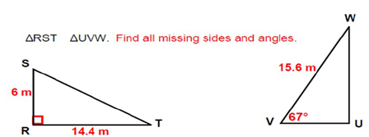
Example Four
$$≅$$

Slide 12
Practice Time!
Make sure you read all directions and show your work!

