Slide 1
Warm-up

Slide 2
Midsegment of a Triangle and Proportionality in Triangles

Slide 3
Triangle Midsegment Theorem

Slide 4
Triangle Midsegment
A midsegment of a triangle is a segment that connects the midpoints of two sides of a triangle.
●
●
midsegment

Slide 5
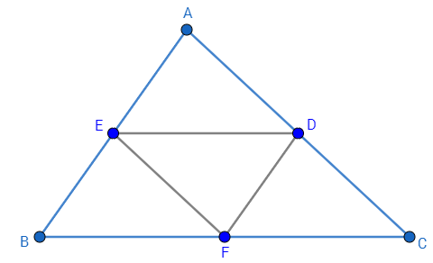
Triangle Midsegment
The three mid segments of a triangle divides the larger triangle into four congruent triangles.

Slide 6
Triangle Midsegment
A mid segment of a triangle is parallel to one side of the triangle.
●
●
midsegment

Slide 7
Triangle Midsegment
A mid segment of a triangle is half the length of the parallel side.
●
●
midsegment

Slide 8
Triangle Midsegment Theorem
EQUATION
Midsegment
Parallel Side

Slide 9
M
M
M
X
Z
X
Z
N
O
N
O
Y
If MX = 3 , then MN= __________.
If NO = 8, then YO=__________.
Label all the lengths we can know on all three triangles from the information above.
Look at the relationship between $∆$MXZ and $∆$MNO. What does this remind you of?

Slide 10
1. Solve for x.
x = 9
x
18

Slide 11
2. Solve for x.
x = 24
12
x

Slide 12
3. Solve for x.
x = 14
3x
84

Slide 13
4. Solve for x.
x = 2
4
5x – 2

Slide 14
5. Solve for the missing variables.
z
x = 12
y = 133°
x
●
●
47°
z = 11
11
y°
●
24

Slide 15
Proportional Parts of Triangles
Be consistent with how you set up the proportion.

Slide 16
Setting up proportions:
STAY CONSISTENT!
LABEL YOUR TRIANGLES (BIG/SMALL OR NEW/OLD)
$$\frac{ }{ } OR \frac{ }{ }$$

Slide 17
1. Solve for x.
4
6
x
x = 8
18

Slide 18
2. Solve for x.
x
8
10
4
x = 20

